Slide 1

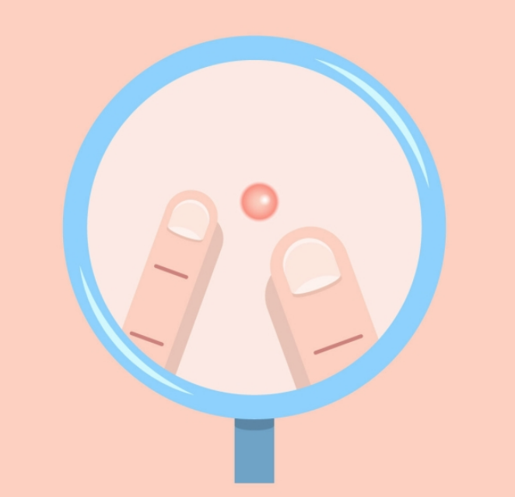
DeepSkin
Detect skin cancer using AI and connect to dermatologist
Haotian Cheng
Sunitha P. Sampath
Boston University

Slide 2
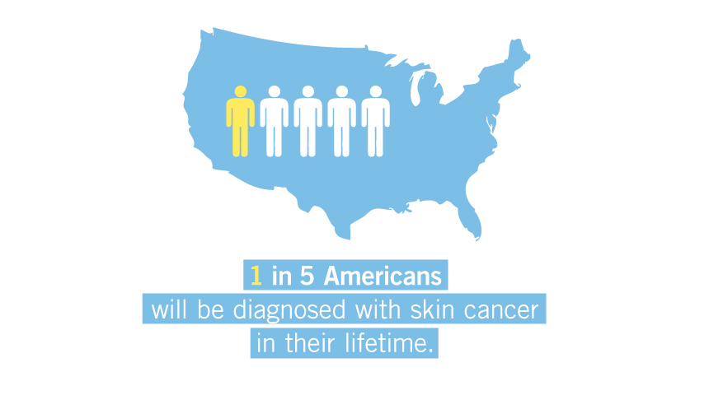
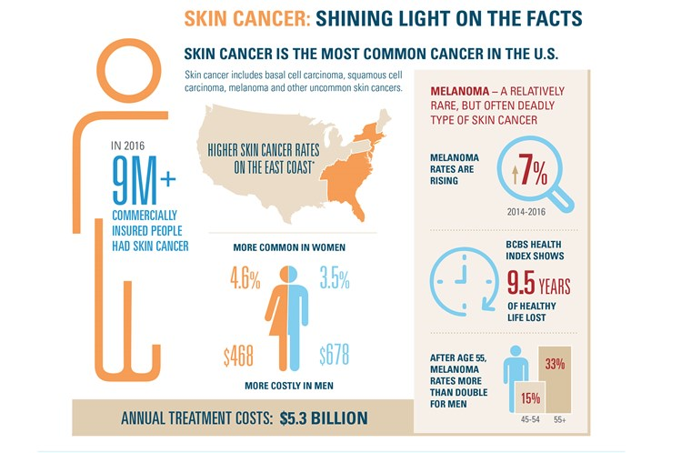
Skin cancer can be deadly

Slide 3
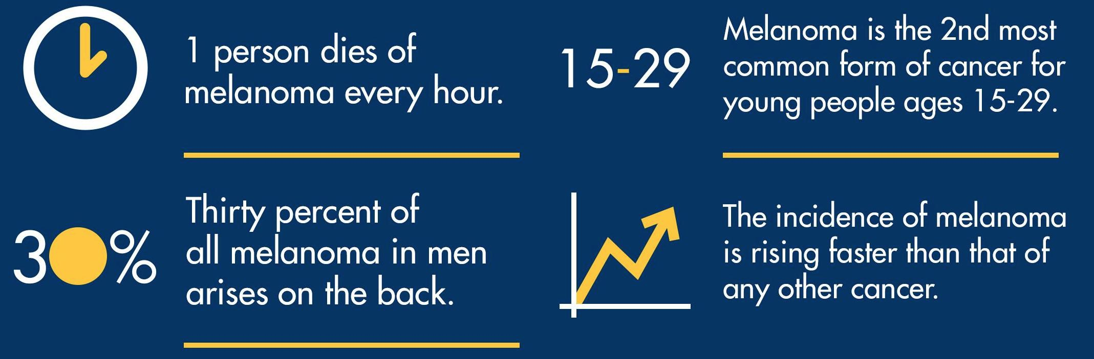
How deadly is melanoma?

Slide 4
How deadly is melanoma?
In 2019, new melanoma cases will increase by 7.7%
In 2019, an estimated 7,230 people will die of melanoma!

Slide 5

Skin cancer is curable if detected early
Survival rate 98% when detected early
Survival drops to 23% when it metastasizes
Treated 30 to 59 days after biopsy - 5% higher risk of dying
Treated 119 days after biopsy - 41% higher risk
skincancer.org

Slide 6
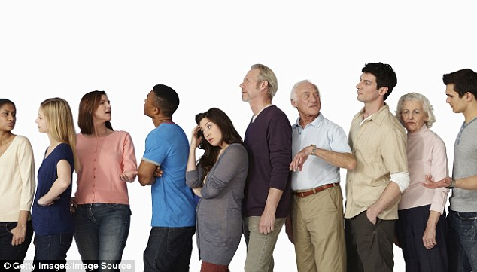
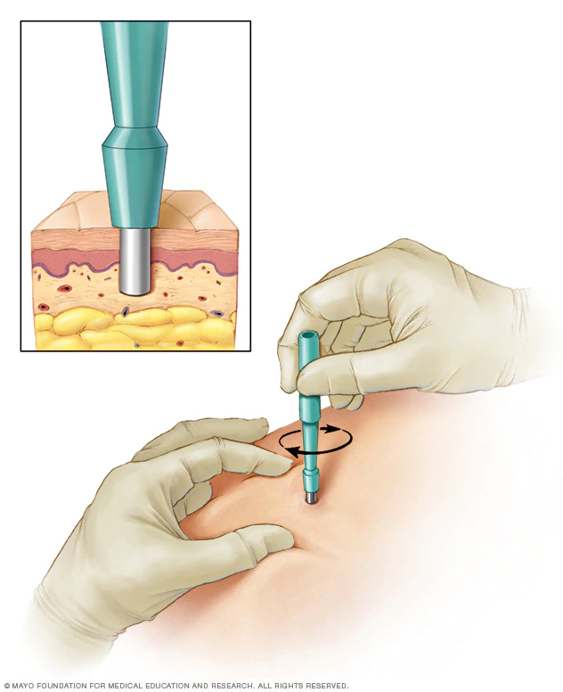
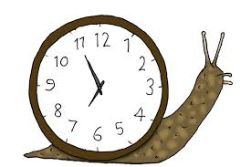
Bottlenecks in delivering skin cancer diagnosis

Slide 7


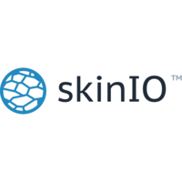

Technology promises to accelerate skin cancer detection
Teledermatology
Fractal geometry
Machine Learning

Slide 8
User Story
As a user, I would want to be able to take pictures of skin lesion.
As a user, I would want to know if the lesion is cancerous.
As a user, I would want the results to be fast.
As a user, I want to ensure the privacy of the images.
As a user, I would want to be recommended to nearby dermatologists or general practitioner.
As a user, I would want to be educated on the results of the detected skin lesion.

Slide 9
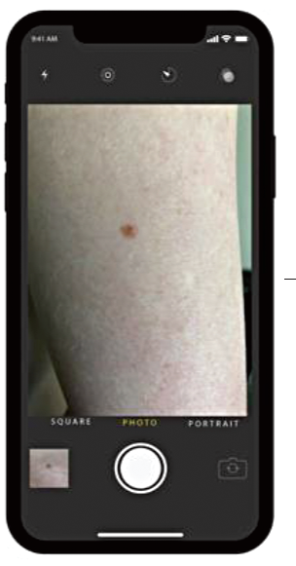
DeepSkin - Detect skin cancer on your own device
planned prototype
Lesion is Captured using mobile camera

Slide 10
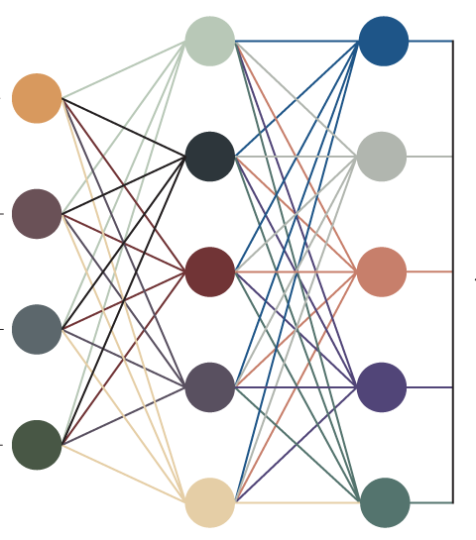
DeepSkin - Detect skin cancer on your own device
planned prototype
Input image is processed using Mobilenet convolutional neural network
Lesion is Captured using mobile camera

Slide 11
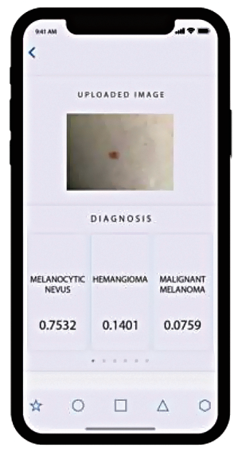
DeepSkin - Detect skin cancer on your own device
planned prototype
Input image is processed using Mobilenet convolutional neural network
The diagnosis is output on the app interface
Lesion is Captured using mobile camera

Slide 12
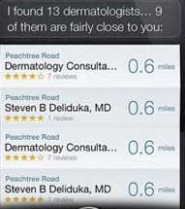
DeepSkin - Detect skin cancer on your own device
planned prototype
Input image is processed using Mobilenet convolutional neural network
Based on the result, nearby dermatologists are recommended
Lesion is Captured using mobile camera
The diagnosis is output on the app interface

Slide 13
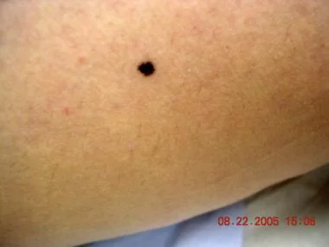
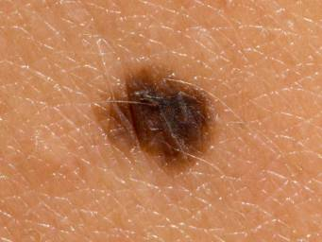
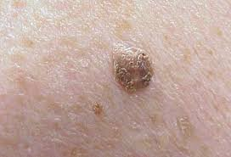
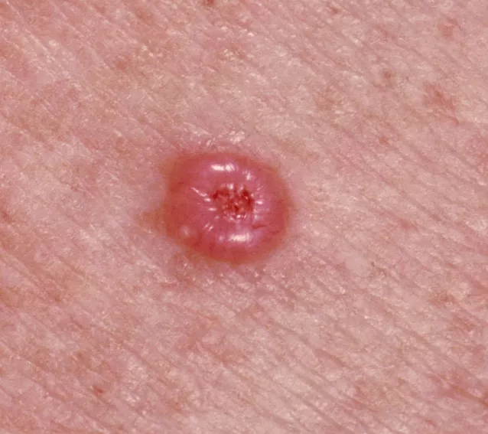
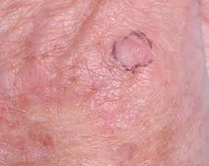
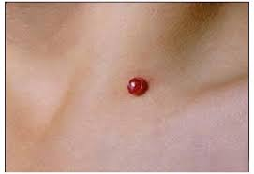
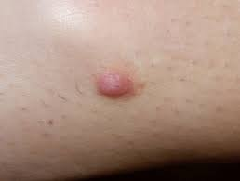
Collected skin cancer dataset from MNIST
Dataset and model resources: Skin Cancer MNIST: HAM10000 and Kaggle
Melanocytic nevi - 6705 images
Melanoma - 1113 images
Benign keratosis 1099 images
Basal cell carcinoma 514 images
Actinic Keratoses - 327 images
Vascular skin lesions 142 images
Dermatofibroma - 115 images

Slide 14
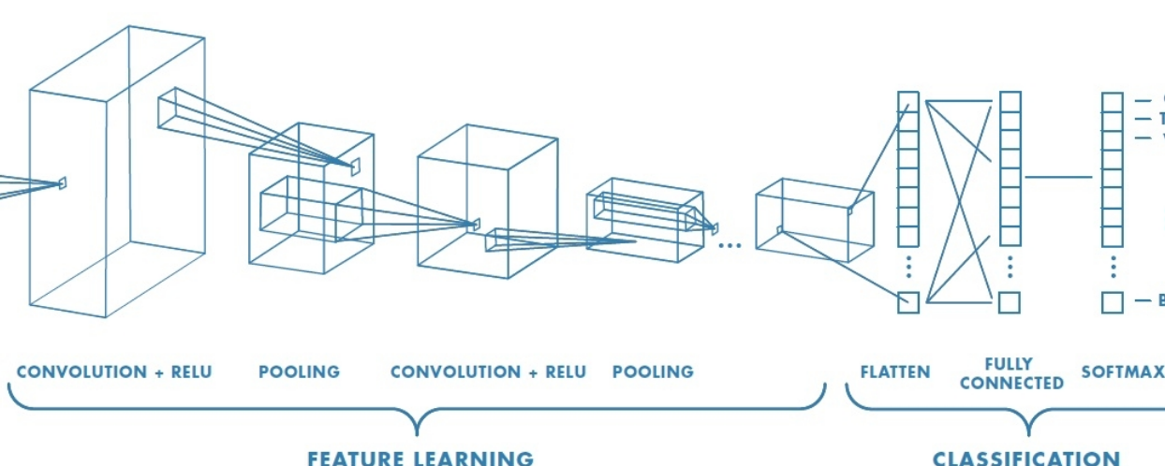
Tested a deep-learning model built using Mobilenet
Melanoma
Adapted from mathworks.com

Slide 15
Why Mobilenet?
Suitable for mobile
Ensures privacy
Small
Fast
Remarkably Accurate

Slide 16
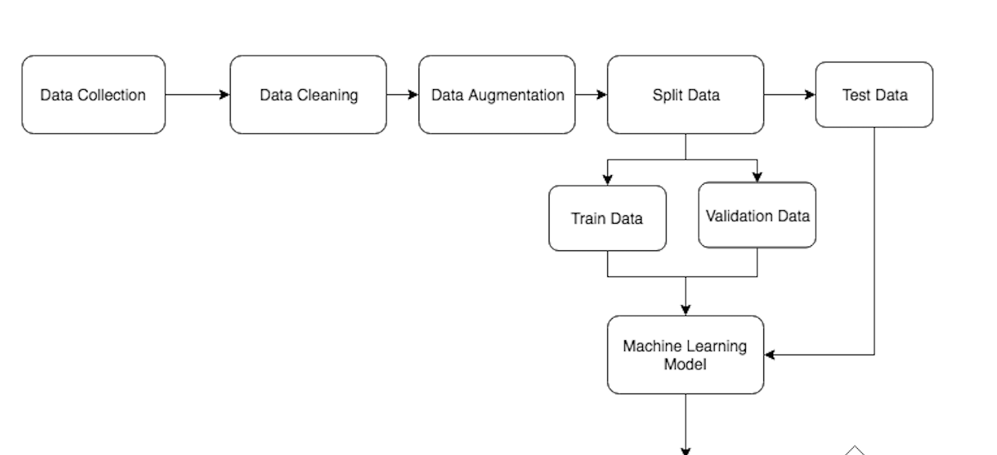
Model Block Diagram

Slide 17
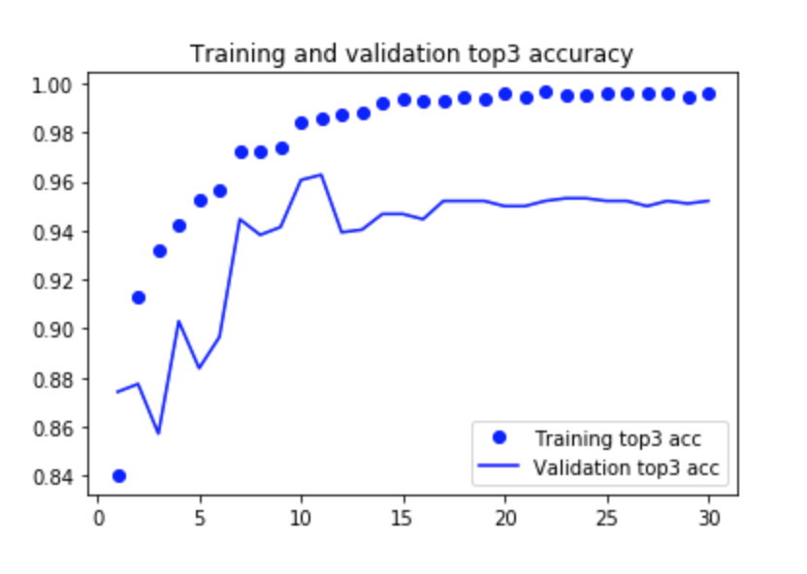
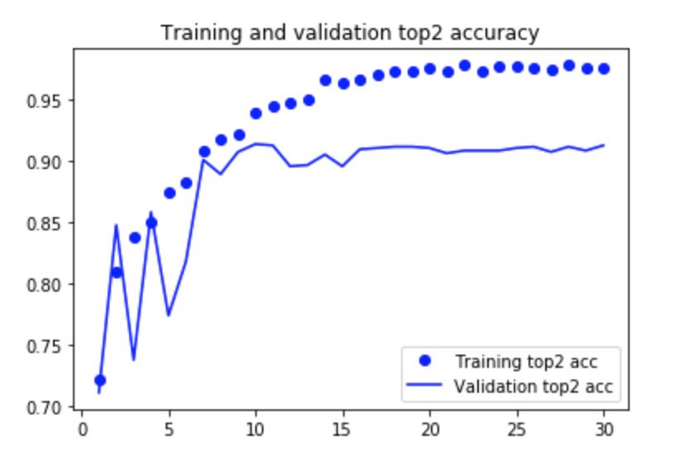
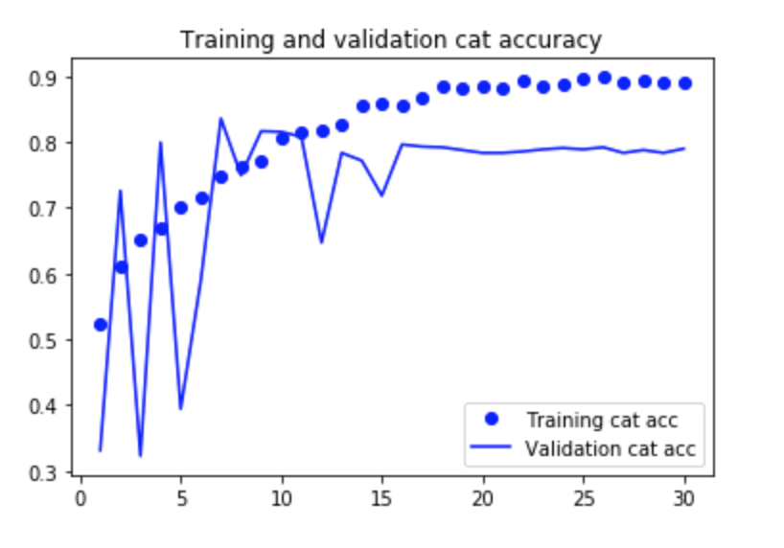
DeepSkin prototype shows promising predictions
Metric | Percentage
Categorical Accuracy | 71.96
Top 3 Accuracy | 87.63
Top 2 Accuracy | 95.41

Slide 18
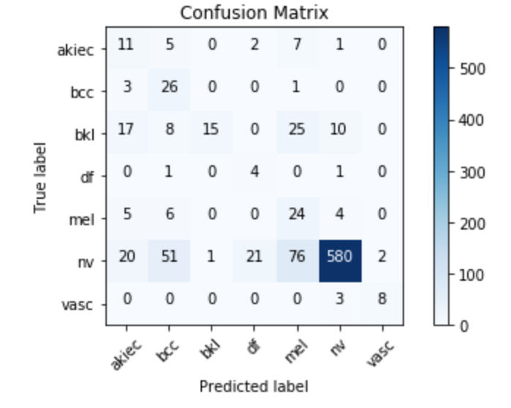
How good is the prediction across skin cancer classes?

Slide 19
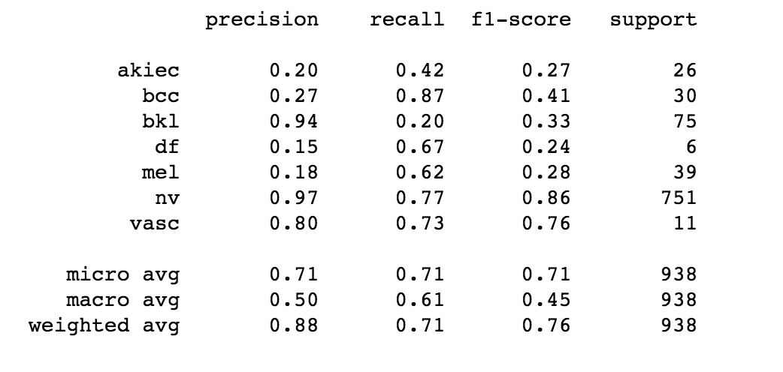
How good is the prediction across skin cancer classes?

Slide 20
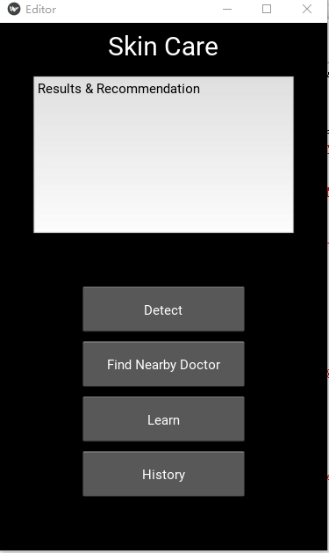
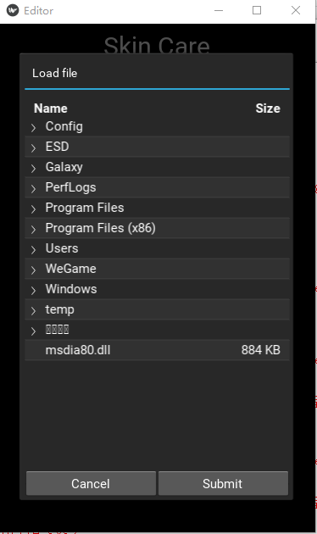
UI Module built using Kivy

Slide 21
Why Kivy?
Python library
Open source
Cross Platform
Write once, deploy to many
UI features

Slide 22
Plan for Sprint 3
Test on more test data
Training to perform better across classes.
Handle challenges related to overfitting of the model.
Complete Google Map API Module
Complete Input Module
Start Video Module

Slide 23
Thank You!

